Slide 1
Weekly meeting
12 14 2023
Ty Bottorff

Slide 2
Outline
Review of conclusions from myocarditis dataset from NCI update
Issue with thyroiditis dataset
Next steps with colitis dataset

Slide 3
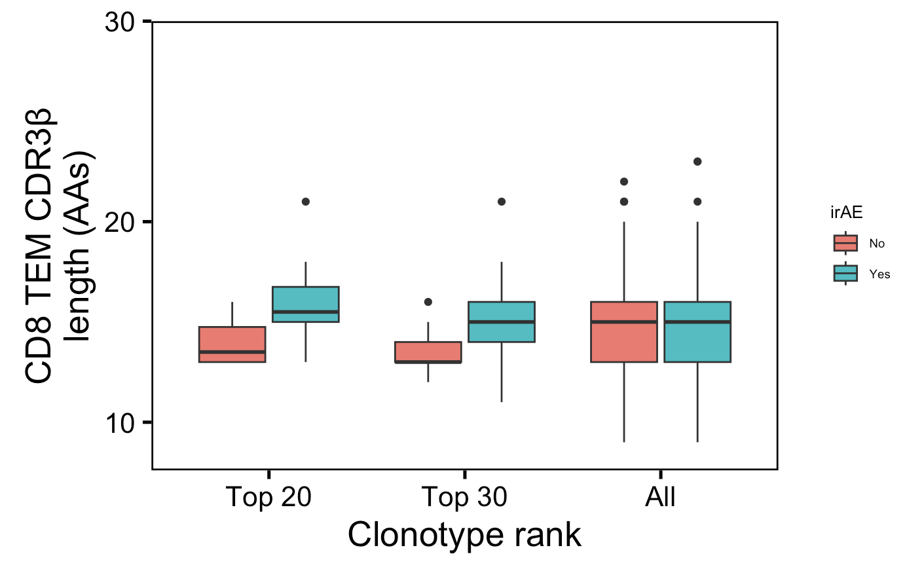
Highly expanded CD8 TEM CDR3βs slightly longer in those developing irAEs
n = 6, 14
n = 9, 22
n = 1265, 1422
n.s.
*
n.s.
Wilcoxon rank sum test. ****, padj <1e-4; **, padj <1e-2; *; padj <0.05
Notes:
Not downsampled but unique!
p = 0.06 for top 20
only a small portion of an antigen is needed to be recognized by a TCR (8-10 amino acids for MHCI, 14-18 for MHCII, does this mean that CD8+ T cells might be more cross-reactive?)
T cell repertoire analysis and metrics of diversity and clonality
CDR1-2 contact MHC and CDR3 contacts peptide is the general rule, but CDR1α also contacts peptide and CDR3β doesn't contact peptide too much
Public refers to clonotype not (CD8 T) cell

Slide 4
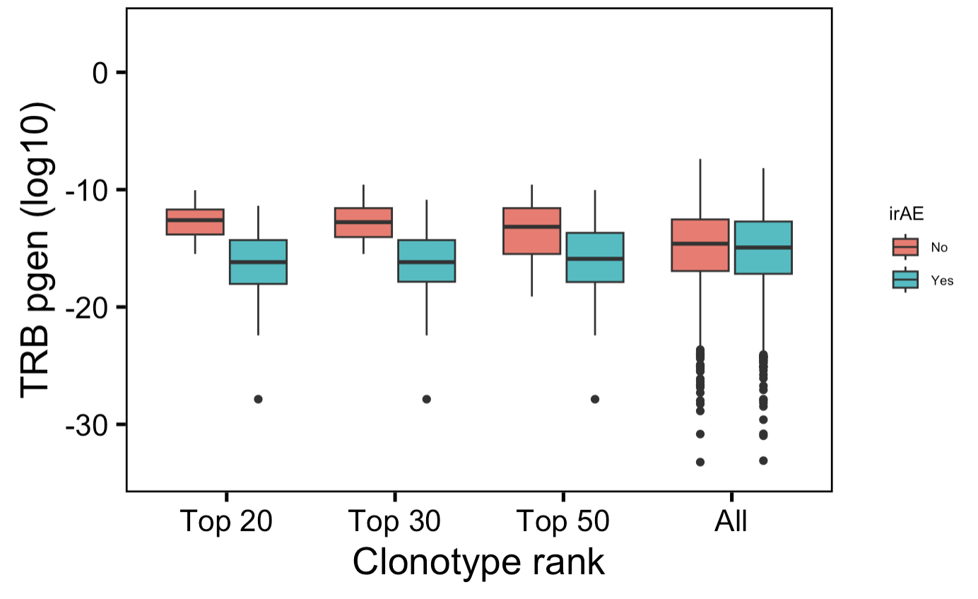
Highly expanded CD8 TEM TRBs less germline-like in those developing irAEs
n = 6,
14
n = 9,
22
n = 13,
39
n = 1265,
1422
→
*
*
*
n.s.
More germline-like
Less germline-like
→
Wilcoxon rank sum test. ****, padj <1e-4; **, padj <1e-2; *; padj <0.05
Notes:
NOT downsampled but unique!
Higher pgen generally means that it's closer to germline because the probability of mutation is lower than not mutation
Public refers to clonotype not (CD8 T) cell

Slide 5
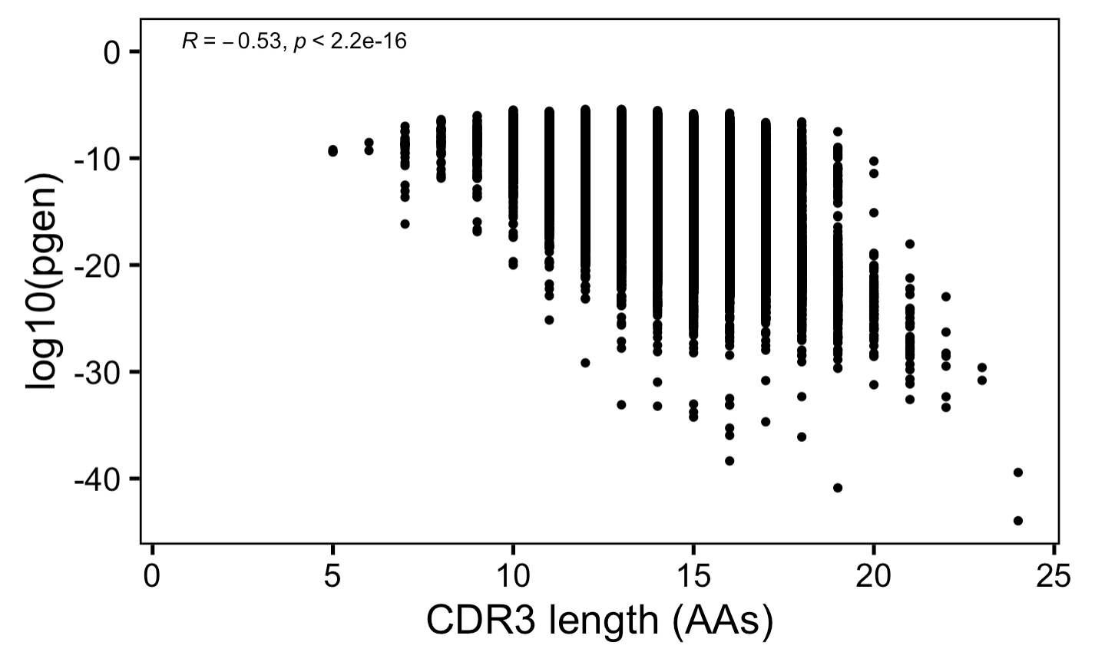
Anticorrelation between CDR3 length and germline-ness
→
More germline-like
Less germline-like
→

Slide 6
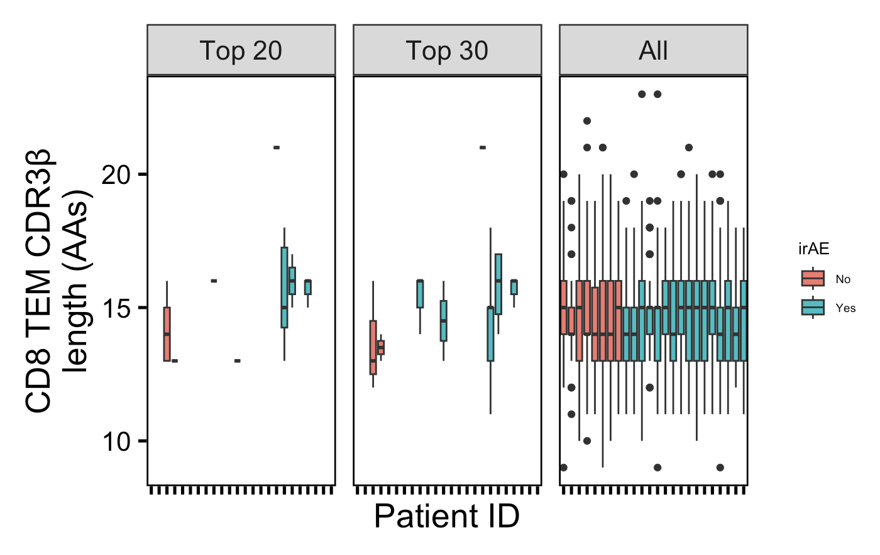
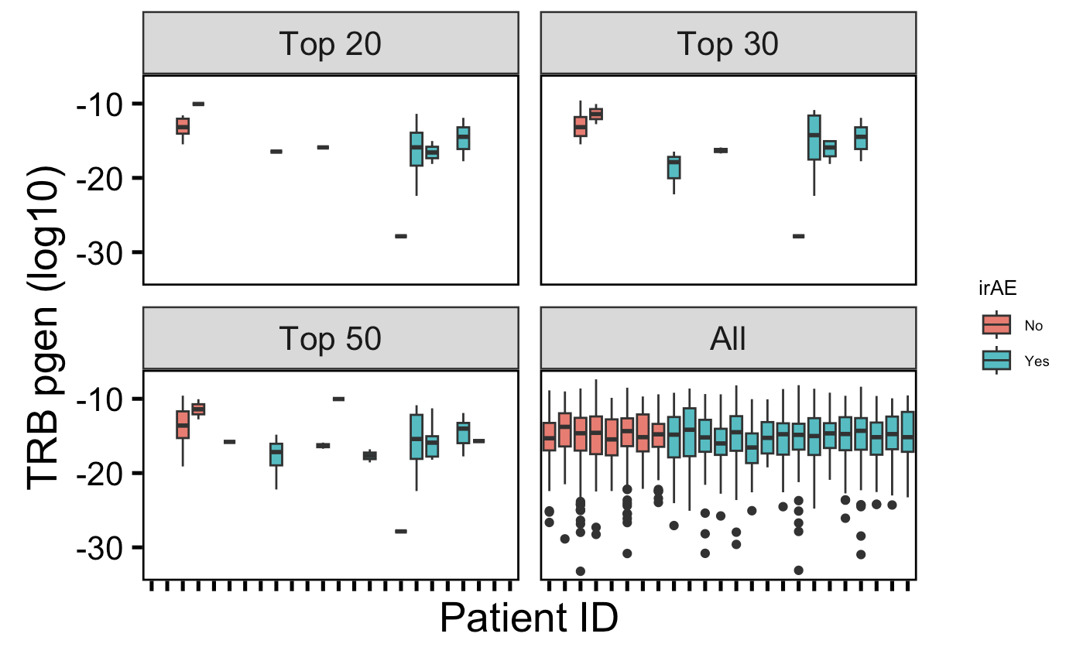
Not all patients are represented in top clonotypes

Slide 7
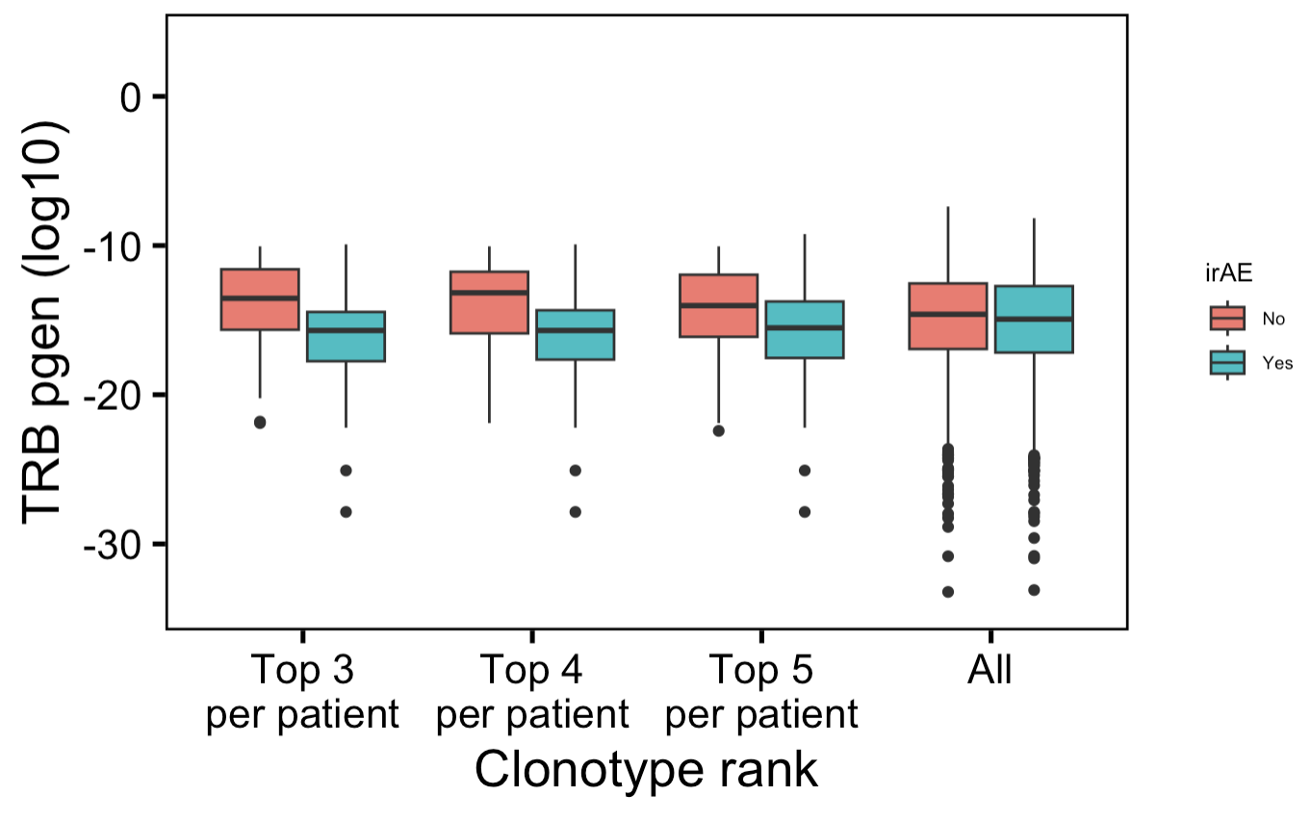
Highly expanded CD8 TEM TRBs less germline-like in those developing irAEs
n = 24,
48
n = 32,
64
n = 40,
80
n = 1265,
1422
→
*
*
*
n.s.
More germline-like
Less germline-like
→
Wilcoxon rank sum test. ****, padj <1e-4; **, padj <1e-2; *; padj <0.05
Notes:
NOT downsampled but unique!
Higher pgen generally means that it's closer to germline because the probability of mutation is lower than not mutation
Public refers to clonotype not (CD8 T) cell

Slide 8
Issues with thyroiditis dataset
No normal thyroid HC T cells passed QC and had TCR seq data
Low T cell infiltration in healthy thyroid
Not sure if worth comparing TCR features between irAE and HT groups…

Slide 9
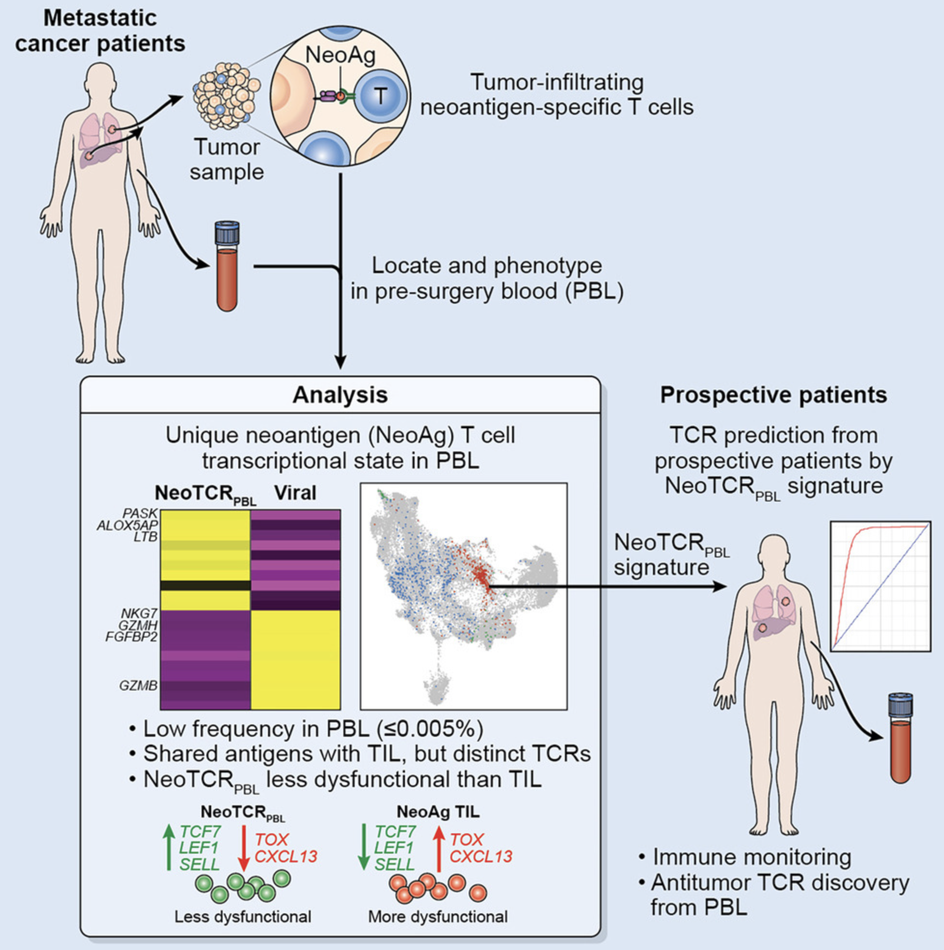
Phenotypic signatures of circulating neoantigen-reactive CD8⁺ T cells in patients with metastatic cancers
Test myocarditis dataset PBMCs
See if CD8 TEM TCR feature conclusions change in +/- NeoTCR_{PBL} transcriptional signature?
Notes:
Seems as though this NeoTCR_{PBL} transcriptional signature may be unique to tumor reactive PBMCs!
circulating tumor reactive T cells: lower expression of cytotoxic molecules, higher expression of T cell activation genes, memory quiescence, tissue residency, inhibitory markers

Slide 10
Conclusions
Within highly expanded CD8 TEMs in those developing irAEs…
less germlike-like TRBs (solid)
slightly longer CDR3Bs (less solid)
Notes:
Context of BRI/VDJdb data…
Public/shorter CD8 TRAs/higher pgen expected more crossreactive from BRI/VDJdb data... (VDJdb not pgen, BRI all 3)

Slide 11
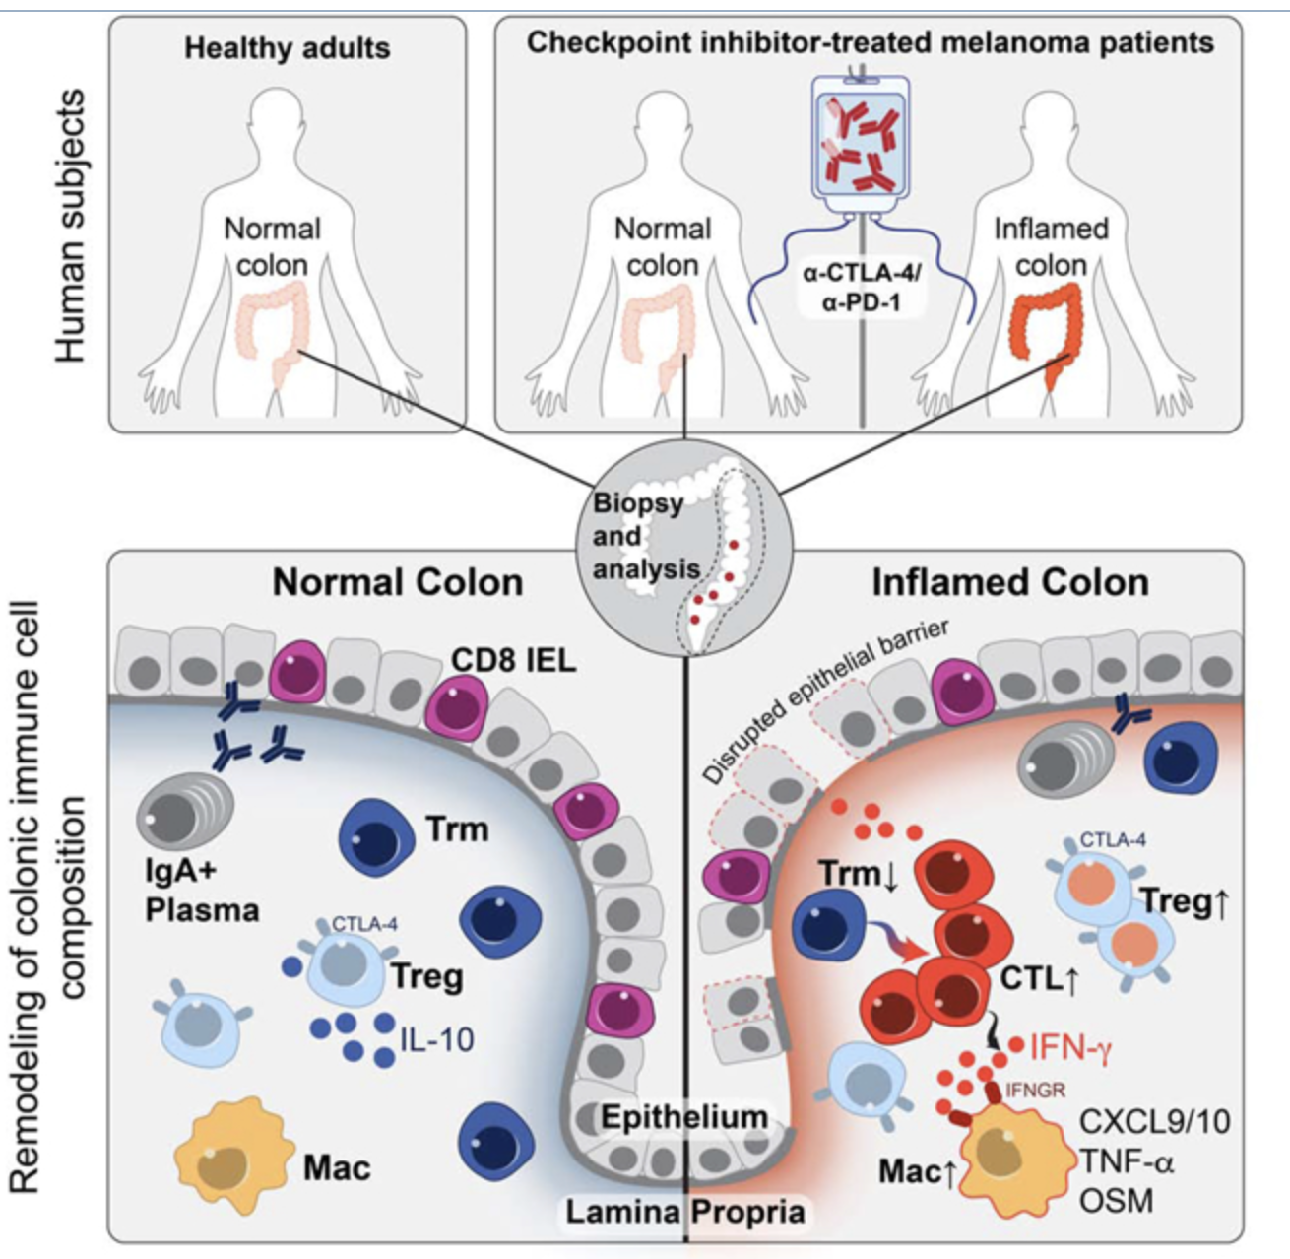
Next steps
Colitis dataset: Molecular Pathways of Colon Inflammation Induced by Cancer Immunotherapy (Cell, 2020)
scRNA & scTCR
Melanoma patients
HC: n = 8
ICB no colitis: n = 6
ICB colitis: n = 8
Hopefully more T cell infiltrates in healthy colon than healthy thyroid
Notes:
Not sure if ICB no colitis had other irAEs… doesn’t matter as much probably given sampling from colon

Slide 12
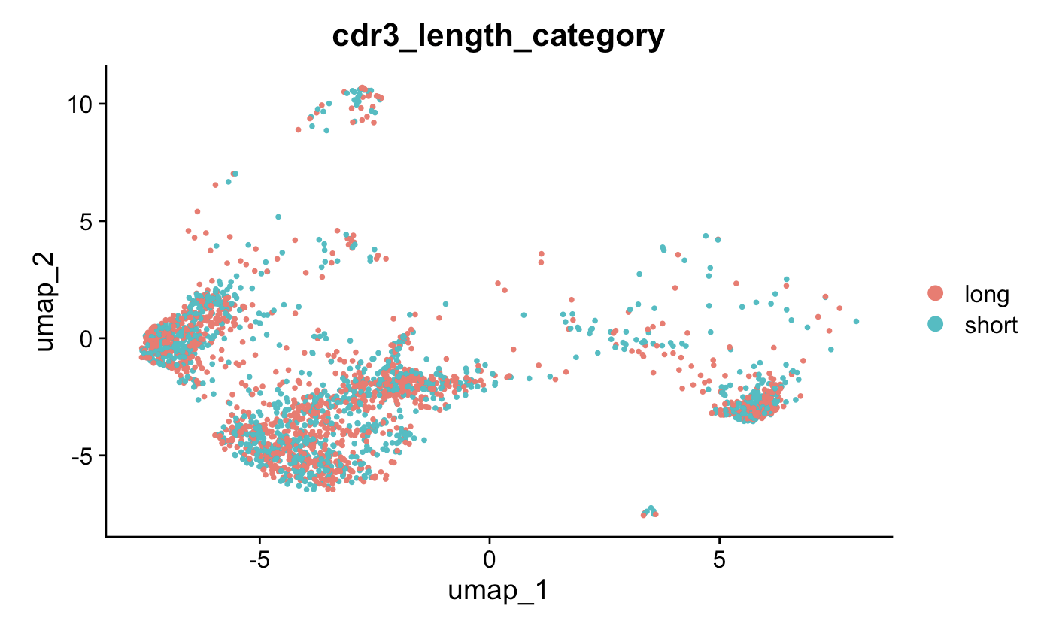
RNA phenotype of cells with longest and shortest TRB CDR3s likely very similar

